Slide 1
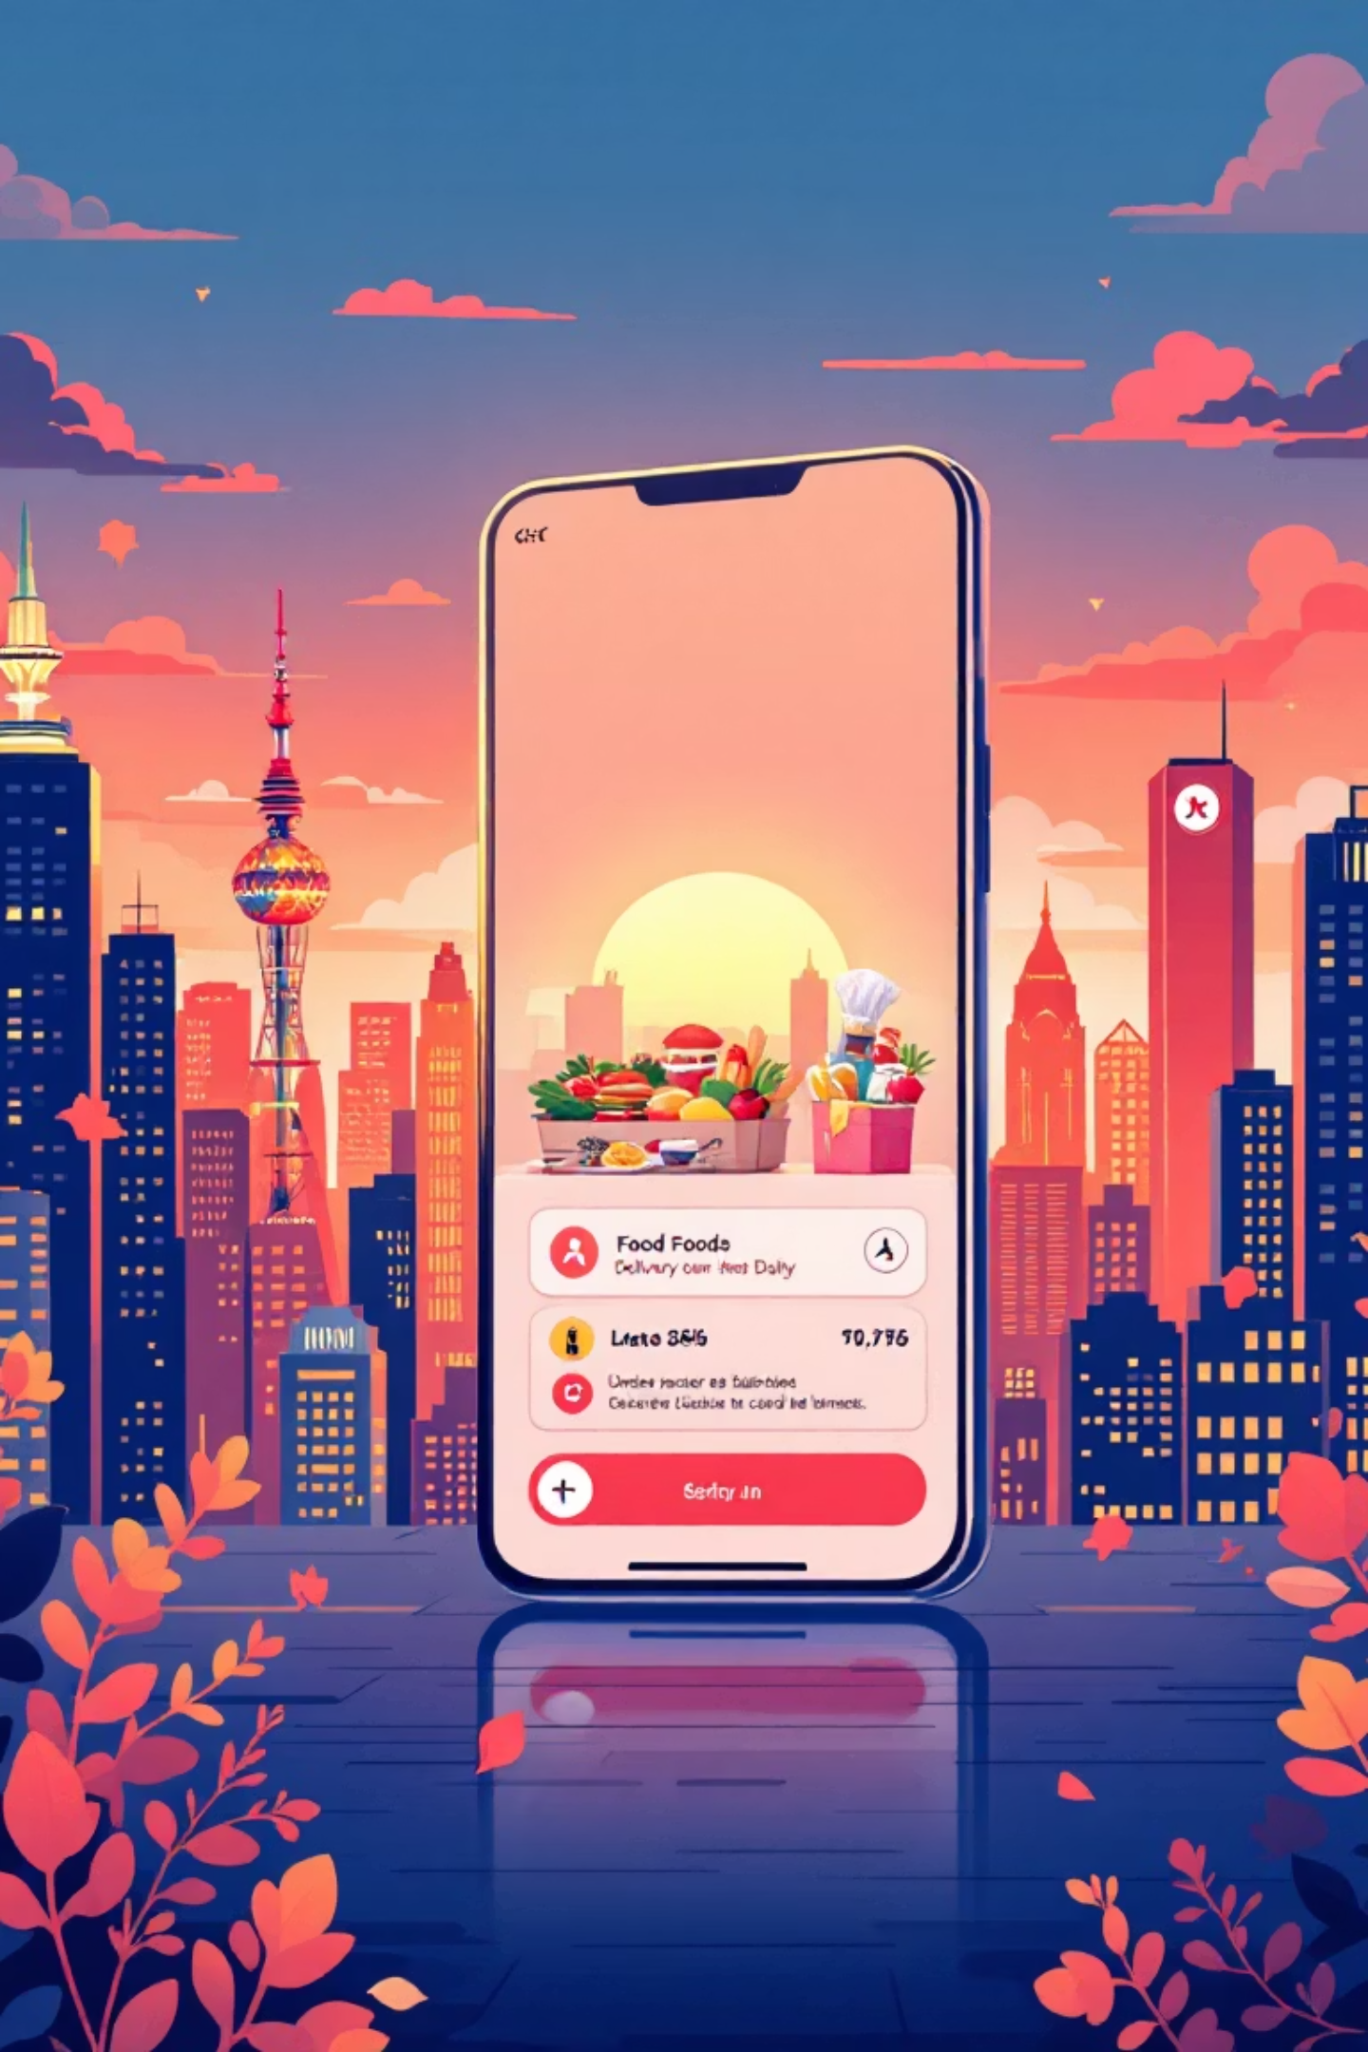
QuickBite Express
Crisis Recovery Analytics Report
Data-driven analysis of the June 2025 crisis impact and recovery performance across customer behavior, order trends, delivery operations, and customer experience.

Slide 2
CRISIS OVERVIEW
The Perfect Storm
What Happened
Orders Collapsed
Customers Left
June 2025 brought a dual crisis: food safety concerns at partner restaurants combined with a week-long delivery outage during monsoon season.
Sharp decline in daily orders and revenue
Significant drop in satisfaction ratings
Partners Lost
Restaurant partners moved to competitors

Slide 3
Analysis Objectives
01
02
03
Measure Crisis Impact
Identify Delivery Issues
Track Customer Experience
Quantify effects on orders, revenue, and customer base
Analyze what's affecting delivery performance
Monitor satisfaction and retention trends
04
05
Monitor City Recovery
Recommend Actions
Track progress across all markets
Provide data-backed recovery strategies

Slide 4
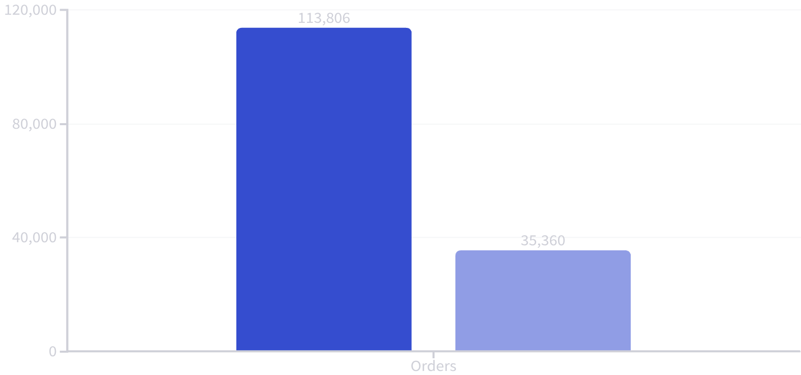
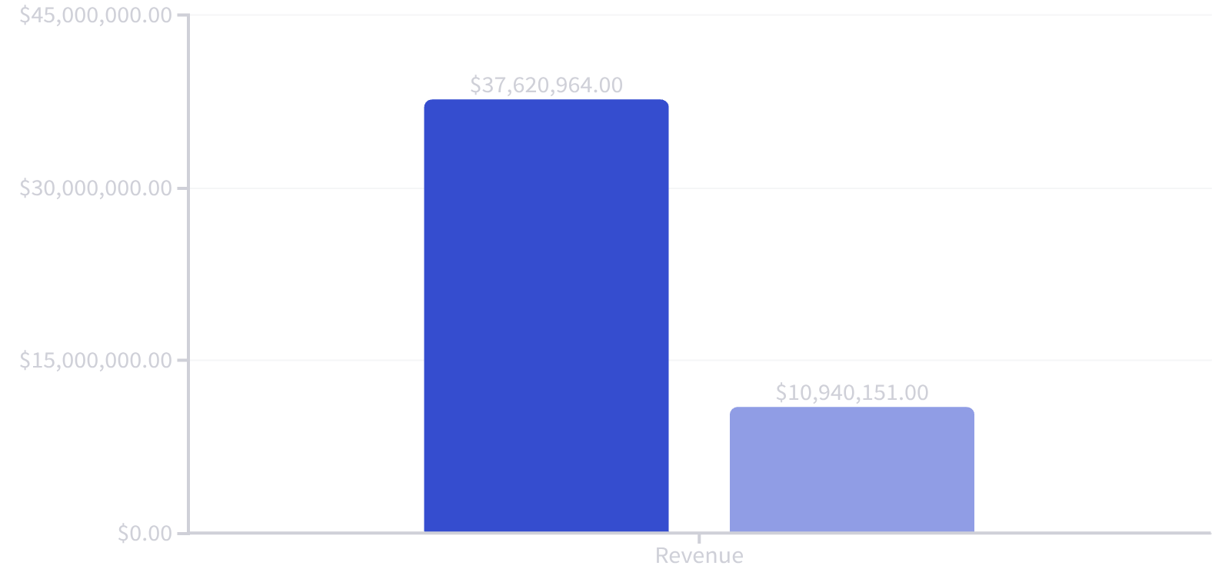
The Numbers Tell the Story
Pre-Crisis
Crisis
Pre-Crisis
Crisis
Comprehensive Impact Summary
The data clearly illustrates a severe downturn during the crisis period. Orders plummeted by 61%, dropping from 113,806 to just 35,360. Even more critically, revenue experienced a drastic 71% loss, resulting in a direct financial impact of ₹2.67 crore during this challenging time.
This sharp decline signifies a major negative impact on overall business activity and earnings, highlighting the urgent need for strategic recovery efforts. Comparing these figures to our pre-crisis baseline, it's evident that the crisis has significantly eroded market performance and financial stability, underscoring the critical importance of effective measures to restore growth and customer confidence.

Slide 5

Customer Exodus
84%
14K
87K
Churn Rate
Returned
Lost Base
72,865 of 86,824 customers did not return
Only 13,959 customers came back during crisis
Active customers before June 2025

Slide 6


Delivery Performance Breakdown
Time Delays Worsened
Average delivery time jumped from 39.52 minutes pre-crisis to 60.12 minutes during crisis—a 52% increase. Recovery phase showed minimal improvement at 60.05 minutes.
Late deliveries increased cancellation rates from 6.47% (on-time) to 8.01% (late), directly impacting customer satisfaction.
63%
8%
Orders delivered late
Late order cancellations

Slide 7
Customer Ratings Plummeted
Pre-Crisis
Recovery Phase
4.5 stars – Strong customer satisfaction
2.4 stars – Ratings remained low, no improvement
1
2
3
Crisis Period
2.5 stars – Sharp 44% drop in ratings
Customer experience did not recover even as operations stabilized, indicating deeper trust and quality issues that need addressing.

Slide 8




City Impact Analysis
Chennai – Worst Hit
Kolkata
Bengaluru
62.48% decline in orders, dropping from 2,307 to 866 average orders
61.49% decline, falling from 2,094 to 807 orders
61.46% decline despite being largest market (5,644 to 2,175)
Mumbai & Delhi
Both saw ~61% declines, showing widespread impact
All cities experienced severe declines between 59.86% and 62.48%, indicating the crisis impact was uniform across regions.

Slide 9

RECOVERY STATUS
Partial Recovery Underway
Revenue Stabilized
₹8.14M recovered, monthly range ₹2.64M–₹2.89M
Ratings Still Low
Crisis
Early Recovery
Peaked at 2.69 in July, declined to 2.31 by September
June: sharp drop in orders and revenue
Stabilization
Sept: gradual demand and revenue improvement
July–Aug: operations steady, partial recovery
Delivery Unchanged
Time remains around 60 minutes, no improvement
Recovery orders at 8.78K represent only 38.6% of pre-crisis levels.
City Recovery
Pune leads at 40%, Chennai lags at 37%

Slide 10






Path Forward: Key Recommendations
Fix Delivery First
Win Back Customers
Focus Organic Channels
Rebuild Restaurant Base
Improve rider availability and route optimization to restore 40-minute delivery times
Launch targeted campaigns for 72K churned customers with discounts and loyalty rewards
Shift budget to Organic (52K) and Referral (14K) channels that drive retention
Re-activate 3.3K lost restaurants with incentives and operational support
Prioritize High-Impact Cities
Quality Over Volume
Support Chennai and Bengaluru with targeted recovery plans and commission relief
Focus on customer experience KPIs, not just order count during recovery
Analysis powered by Python, SQL, and Power BI | January–September 2025 data

